Slide 1


FACIAL EMOTION
DETECTION
Using Machine Learning

Slide 2

PROJECT TEAM
PATRICK BACZA
ALLISON WELLS
WILLIAM BROWN
CHRIS WINN
SYED HUSAIN

Slide 3
AGENDA
01
02
03
04
FER Overview
Approach and model description
Results
Real-time demo

Slide 4
WHAT IS FACIAL EMOTION RECOGNITION?
Technology that analyzes facial expressions to help determine emotional state
Uses static images and/or videos
Goal to automate the process of determining emotions in real-time
Analyzes various facial features (eyebrows, eyes, mouth, etc.)
Decoding emotion expressions an interest for decades in psychology
AI/deep learning utilized to automate and increase accuracy
CNN ideally suited for this effort
55% of emotional information is conveyed visually (Mehrabian, 1967)

Slide 5
POSSIBLE USES OF EMOTION RECOGNITION
Check emotions at live performances
Real-time customer satisfaction
Product testing
Market research- focus groups
Political debate/town hall audience reaction
Education- curriculum adaptation
Mental health diagnosis
Employee safety
Patient care
Automotive safety
Video game- adapt to player mood
Fraud detection
Virtual personal assistants/robots
Employee interviews

Slide 6

CONCERNS
Data Privacy
Data breaches
Transparency and informed consent
Inference of special categories of personal data (health data, political opinions)
Accessibility of data by non-authorized entities (employers, health insurers, etc.)
Data accuracy
Multiple emotions experienced simultaneously
Camera angles, lighting
FER usually treated as 100% accurate
Fairness
Racial/cultural bias
Medical conditions causing misclassification
Media and academic criticism
“Microsoft is removing emotion recognition features from its facial recognition tech”, NBCNews.com, June 27, 2022
“Artificial Intelligence Is Misreading Human Emotion”, The Atlantic, April 27, 2021

Slide 7
FER2013 CONTEST
CONTEST
# OF ENTRIES
Associated with ICML 2013 Workshop on Representative Learning
56 teams Only 4 beat “null” model (CNN with no learning except in final classification layer)
PRIZE MONEY
WINNING ACCURACY
First Prize- $350
Second Prize- $150
(generously donated by Google)
71.162%

Slide 8
FER2013 DATASET
GREYSCALE IMAGES OF FACES
7 CATEGORIES OF EMOTIONS
ROBUST DATASET
48 x 48 pixels
Angry | Fear | Disgust | Happy | Sad | Surprise | Neutral
35,888 faces

Slide 9
RESOURCES USED
AWS/S3
TensorFlow/Keras
Pandas
SKLearn

Slide 10
APPROACH
Preprocess data
Create model
Evaluate model
Make predictions

Slide 11
Preprocessing
Create arrays for each image
Separate out the emotion assigned to each image
Split data into the test and training data sets
Apply Data Augmentation to the data

Slide 12
Data Augmentation
Method used to alter images in the dataset ex. rotate, zoom in, flip it, increase width , increase height.
Benefits:
Increases the size of the data set .
Exposes model to a wider range of variation in the data which makes the model stronger and better to handle real world scenarios where images will have all different types of orientations and sizes.
Reduces overfitting - Since random variations are added to the data, the model is prevented from relying too heavily on specific details or relationships within the data.
Can address class imbalance.
Overall, the model will be much better at making predictions on new unseen data.

Slide 13
Data Augmentation
Rotation range = 20 - rotates images randomly within a range of -20 to 20 degrees
Width shift range = 0.2 - shifts width by up to 20% of total width
Height shift range = 0.2- shifts height by up to 20% of total height
Shear range = 0.2 - Changes the viewpoint of the image with range of -0.2 to 0.2
Zoom_range = 0.2 - zooms in images by up to 20%
Horizontal flip = True - Mirrors image
Fill mode = nearest - Fills in any empty pixels with the values of the nearest pixel

Slide 14
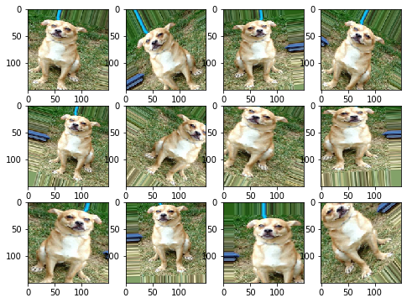

Slide 15
Layer Definitions
Convolutional Layer - A filter or window that slides over the input data, capturing local patterns or features.
Dense layer - a layer where every neuron is connected to every neuron in the previous layer. It performs a linear transformation followed by a nonlinear activation allowing the network to learn and represent complex patterns in the data.
Batch normalization - Adjusts values of the inputs within each mini-batch of training data to ensure that they have similar statistics, such as mean and variance. Helps the network learn more efficiently
Dropout Layer - Randomly deactivates a fraction of the neurons in a layer during training to introduce noise and prevent overfitting. It forces the model to learn more independent features
Maxpooling layer - Divides the input data into non-overlapping regions and selects the maximum value from each region. By selecting the maximum value from each region, it captures the strongest activation or presence of a feature in that region.

Slide 16
Creating the model
At first, the model did really well on the training, but not on testing. Overfitting
Approaches to overfitting:
Drop out layers
Data Augmentation
Adding more learning layers (dense layers)
Slower learn rate

Slide 17
Creating the model
Added dense layers to increase learning
Removed dense layers and decreased drop-out
LEARNING
SIMPLIFY
INITIAL
OVERFITTING
TESTING
Increasing drop-out layers and experimenting
Used data augmentation to combat
Real time application with webcam view.

Slide 18
Final Model
10 Convolutional layers
Between 64 and 512 neurons for each layer
8 batch normalization layers
4 max pooling layers
3 dropout layers
Each deactivation rate is set at 10%
1 dense layer
Output layer
Training Accuracy: 69.7%
Training loss: 0.82
Testing Accuracy: 66.5%
Testing Loss: 0.93

Slide 19
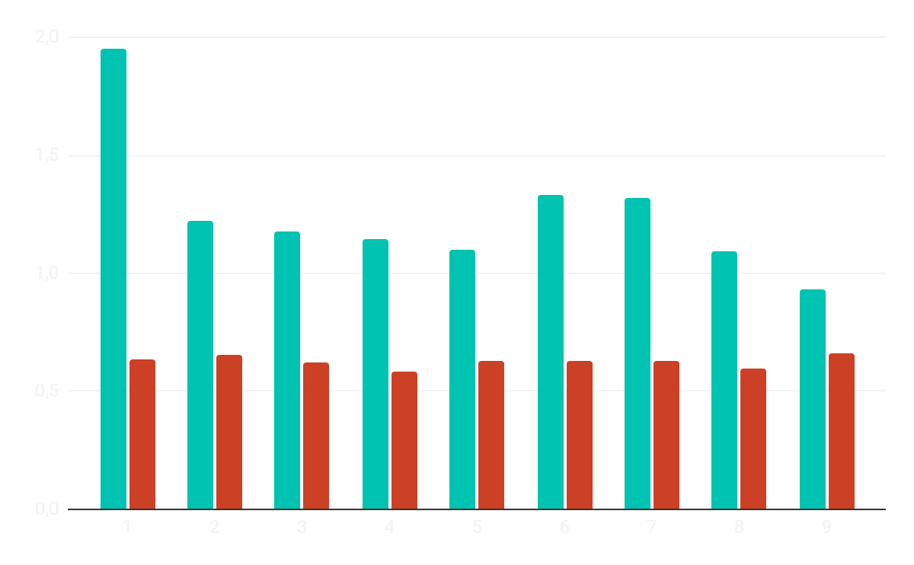
RESULTS
LOSS
ACCURACY

Slide 20

DEMO
Real-time FER

